Slide 1
Fertility
Sexuality Day 2

Slide 2
Requirements for Male Fertility
Normal sperm production, which includes the following:
•Healthy ductal system
•Normal sperm count
•Sperm mobility
•Biological structure and functioning of sperm
Transmit sperm to female vagina through:
•An adequate sexual drive
•The ability to maintain an erection
•The ability to achieve a normal ejaculation
•The placement of ejaculate in vagina

Slide 3
Requirements for Female Fertility
Adequate sexual drive and sexual function to permit coitus.
Functioning reproductive anatomy and physiology that include:
•Vagina capable of receiving sperm
•Normal cervical mucus to allow passage of sperm through the vagina and cervix
•Ovulatory cycles
•Fallopian tubes that will function to permit the sperm and ovum to meet and allow migration of the product of conception to the uterus
•Uterus capable of developing and sustaining an embryo to maturity
•Adequate hormonal status to maintain pregnancy and fetal survival
•Adequate nutritional, chemical, and health status to maintain nutrition and oxygenation of placenta and fetus

Slide 4
Infertility: The inability to conceive children
It is a malfunctioning of the reproductive system.
•No conception after twelve (12) months of unprotected regular intercourse, or multiple miscarriages constitutes infertility
•Estimated that 10-15% of couples are not able to conceive within one year of trying. However, the majority of couples do conceive whether or not they are treated for infertility.
Primary Infertility
Never had children
Secondary Infertility
Has had children in the past but is now unable
Tertiary infertility:
A woman has conceived but is unable to produce a live birth.

Slide 5
The Most Common Causes of Infertility
•The woman not ovulating
•The man not producing enough healthy sperm
•Some barrier to transport sperm or ovum through the woman’s fallopian tube (e.g., scar tissue in the fallopian tubes)

Slide 6
Of All Infertile Couples…
•Male is responsible for 40%
•Female is responsible for 40%
•10% is combined responsibility
•10% is unexplained

Slide 7
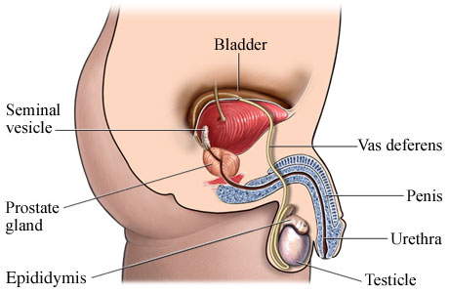
Review of Male Anatomy

Slide 8
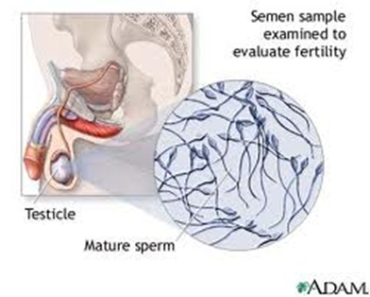
How is Infertility Diagnosed in Males?
Quick, easy tests
- Medical history and examination
- Ejaculated sperm are evaluated
The sperm is checked for several factors
Sperm count between 20 to 100 million per mL is normal
Movement – 50% should be motile 1 hour after ejaculation
Morphology -Maturity and shape (quality)
Volume – 1 teaspoon us sufficient
Acidity – should be slightly acidic

Slide 9
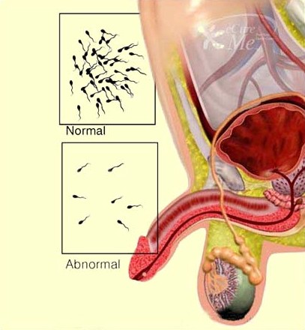
The most common cause for male infertility is a problem with the sperm
Either low sperm count or sperm with poor quality.
Sperm with poor quality cannot move rapidly enough or in the right direction, or may be abnormally shaped.

Slide 10
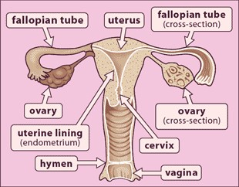
Review of Female Anatomy

Slide 11
How is Infertility Diagnosed in Females?
If a woman has an infertility problem, she will be referred to a doctor who specializes in reproductive endocrinology.
Simple Tests:
- Blood tests and urine tests to check hormone levels.
- A Pap smear to study the health of the cervix.
- Urine tests to evaluate LH surges.
- A basal body temperature test
- An endometrial biopsy – Tells the doctor if eggs have been released as well as whether there is enough progesterone.
- An ultrasound to look for fibroids and cysts in the uterus and ovaries.
- A post-coital test: must be done within 12 hours of intercourse to see if the man’s sperm can survive the cervical mucus.

Slide 12
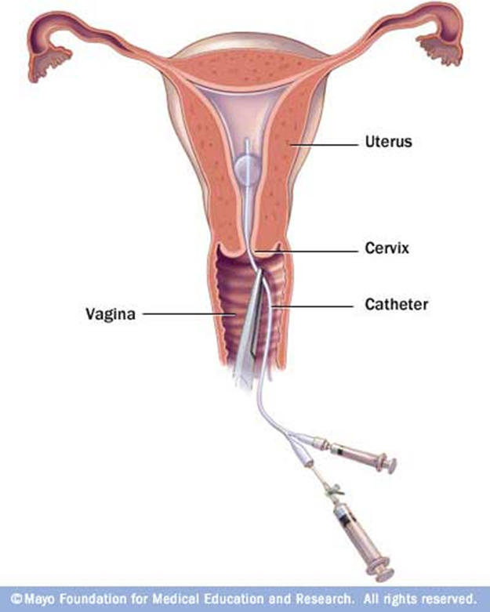
How is Infertility Diagnosed in Females?
More Complex Tests?
Laparoscopy: Looks for ovarian or fallopian tube scarring or endometriosis.
A Hysterosalpingogram: checks the condition of the fallopian tubes by using dye and X-rays. It can reveal:
Blocked fallopian tubes, fibroid tumours, structural abnormalities and endometrial polyps.

Slide 13
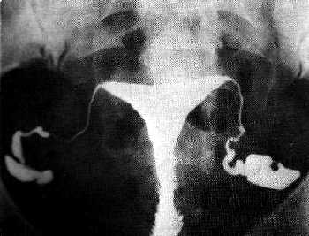
Hysterosalpingogram

Slide 14
Factors Affecting Reproductive Health
Fall under the following categories:
•Environmental (e.g., chemical exposure)
•Nutritional (e.g., anorexia)
•Hormonal (e.g., imbalance affecting cycle)
•Sexual History (e.g., STDs)
•General Health (e.g., cancer)
•Physiological Response to Stress (e.g., may disrupt menstrual cycle, change in sexual interest, change in appetite)

Slide 15
Environmental Factors
Smoking
Females
•Lowering folic acid, vitamin C, zinc and beta-carotene level (all associated with infertility, delay in conception, ectopic pregnancy and menstrual disorders).
•Have an increased risk of spontaneous abortion, fetal and neonatal death
•Lower birth weight in child due to reduced nutrients and oxygen to the fetus in utero
Males
•May have quality of sperm affected
•Marijuana may have the quality of their sperm reduced

Slide 16
Environmental Factors
Alcohol
•Reduces sperm quality in males
•Affects ability to achieve and/or maintain erection

Slide 17
Environmental Factors
Chemical Exposure
•A teratogen can be a drug, or chemical, or an infection that results in the permanent damage to the developing fetus
•There are approximately 25 chemicals known to be teratogenic
•Avoid as many chemicals as you can, including garden weed killers, paints and paint removers, dry-cleaning fluid, household cleaners, fly and flea sprays, etc.
•The following can result in low birth weight, still birth, and birth defects:
•Carbon monoxide in car exhaust
•Kerosene heaters
•Lead and paint strippers

Slide 18
Nutritional Factors
E.g. Anorexia, Bulimia
Medications
Narcotics (e.g., Percodan), tranquilizers (e.g., Valium), anti-depressants (e.g., Prozac), and antihypertensives (e.g., blood pressure medications) may cause erectile dysfunction in males
• Other drugs may affect sperm production and/or ovulation
• Some drugs may cause fetal defects
• Chemotherapy may affect sperm quality and ovulation, and indirectly affect fertility due to nutritional status
• Some herbs contain drug-like ingredients and can have harmful effects during pregnancy and while breastfeeding
• Healthy eating ensures the proper nutrients required pre-conceptually and prenatally
Fetal defects can occur as a result of other drugs, such as tetracycline (antibiotic), Accutane (severe acne treatment), anticoagulants, steroids. Harmful effects from some herbs during pregnancy or while breastfeeding can stimulate the uterus or cause uterine contractions, act as a diuretic, produce toxic effects in the developing baby, cause birth defects, infant deaths, or be passed onto the infant through breast milk and harm the baby.

Slide 19
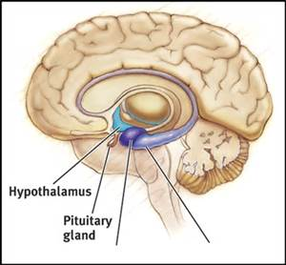
Hormonal/Genetic Factors
•Can affect sperm quality, production, and ovulation (e.g., failure to ovulate regularly, or irregular menstrual cycle, may be caused by problems with the hypothalamus and pituitary gland)
•Congenital factors may impede ability to conceive (e.g., born without uterus)
Under-developed testes-usually arising after a mumps infection, a hernia surgery, an injury or birth defect.
Swollen veins in the scrotum.
Undescended testes-a problem often present from birth in which the testes remain in the body cavity. Normally they descend into the scrotum before birth.

Slide 20
Sexual Health History
•A lack of understanding of reproductive biology and lack of awareness of fertility methods impact fertility
•Multiple sexual partners increase the risk of sexually transmitted infections (STIs), Pelvic Inflammatory Disease (PID), and cervical cancer
•STIs (e.g., chlamydia, gonorrhea) and pelvic conditions, if left untreated, can cause conditions in both males and females, which can impair fertility
•Genital chlamydia infection (leading cause of preventable infertility and ectopic pregnancy)
•80% of women and 25% of men with chlamydia exhibit no symptoms
•50% of women and 25% of men with gonorrhea exhibit no symptoms
•PID can cause tubal damage in women and increase the risk of ectopic pregnancy
•Inflammatory effects of infection in male reproductive organs can cause scarring
•Human Papilloma Virus (HPV) is often a precursor to cervical dysplasia
•Cervical treatments may reduce fertility by causing scarring or damage to cervical mucus producing cells
•Lifestyle choices can affect nutrition, physical activity, and healthy sexual practices effect overall health and fertility status
•Infectious diseases, such as mumps after puberty, can cause sterility

Slide 21
General Health
•Endometriosis can cause scarring, tubal blockage, and possible immune responses (Note: 25-30% of infertile women have endometriosis)
•There is conflicting evidence that tight clothing may affect sperm production (e.g., skinny jeans)
Exercise
•Moderate, regular exercise is shown to have beneficial effects on stress levels, weight, and
hormonal production–clearly good things for fertility.
•However, excessive exercise can have the reverse effect, with the body going into overdrive and
often stopping the monthly cycle altogether. Strike a balance!
Weight
•Weight can be affected by lifestyle factors, such as smoking, stress, and exercise
•In order to conceive, it is important that you are not overweight or underweight–both affect the
body’s normal hormonal function and can halt ovulation altogether.
•If underweight, the body decides it can not maintain a pregnancy, so it often shuts down the
reproductive system.
•Studies have shown that if overweight, losing just 10% of that weight can increase your chances of
conception. You should also avoid crash diets when trying to conceive.

Slide 22
Physiological Response to Stress
•Psychological stress (e.g., depression, anxiety, difficulty sleeping) and physiological stress (increased muscle tension, lack of energy, nervousness) affect libido
•Stress affect the ability to make healthy lifestyle choices (e.g., alcohol and other substance use, smoking, decrease in physical activity or sedentary living, poor nutrition) which, in turn, also affects fertility

Slide 23
FYI: Males What Category?
The most common cause for male infertility is a problem with the sperm
Either low sperm count or sperm with poor quality.
Sperm with poor quality cannot move rapidly enough or in the right direction, or may be abnormally shaped.
Retrograde Ejaculation: The muscles of the urethra do not force the sperm out. Instead, the sperm travel backward into the bladder.
Excessive use of alcohol has been shown to lower sperm count. Alcohol may also interfere with the ability to maintain an errection

Slide 24
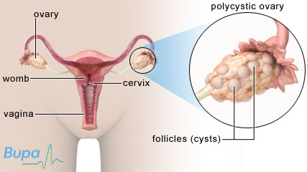
FYI Females: What category?
Most likely cause of infertility in females is
Pelvic Inflammatory Disease (PID) - It's an infection of the pelvis or one or more of the reproductive organs, including the ovaries, the fallopian tubes, the cervix or the uterus.
PID usually stems from the same bacteria that cause sexually transmitted diseases, such as gonorrhea or chlamydia. Chlamydia, in fact, causes 75 percent of fallopian tube infections.
Polycystic ovary syndrome (PCO) - Another major cause of infertility. Due to hormones in the wrong quantities, follicles do not produce eggs. Instead they form fluid-filled cysts that eventually cover the ovaries.
caused by the failure of muscle, fat and liver cells to accept glucose

Slide 25
Endometriosis: refers to a condition in which sections of the uterine lining implant in the vagina, ovaries, fallopian tubes or pelvis. These implants eventually form cysts that grow with each menstrual cycle, and may eventually turn into blisters and scars. The scars can then block the passage of the egg.
Other sexually transmitted diseases such as genital herpes can decrease fertility.
Surgical Complications - Scar tissue left after abdominal surgery can cause problems in the movement of the ovaries, fallopian tubes, and uterus, resulting in infertility. Frequent abortions may also produce infertility by weakening the cervix or by leaving scar tissue that obstructs the uterus.
Uterine muscle problems - Some women may produce weak, infrequent or abnormal contractions in the uterus. During ovulation, these contractions usually push the sperm up to the fallopian tubes.
Poor quality cervical mucus - Sometimes a woman's mucous fails to thin around the time of ovulation, and consequently it prevents the sperm from traveling through it.

Slide 26
Treatment
When couples are infertile, they may opt for some form of help in order to conceive. There are a number of treatments available, and 85-90% of cases are treated with drugs or surgery.
Males
Sperm aspiration is a procedure used to get viable sperm from the male.
Corticosteroids - These drugs can aid men who make antibodies to reject their own sperm, but they may also have serious side-effects after long use.
Viagra - The medication improves blood flow to the penis, resulting in an erection. Studies have revealed that 70 percent of men who used Viagra improved their ability to maintain an erection.
Females
•Hormones are used to stimulate egg production.
•Pelviscopy is used for treating ectopic pregnancy. Ectopic pregnancy is when the embryo implants outside of the uterus. Pelviscopy is also used to treat uterine fibroids, ovarian cysts and tumors, endometriosis, and pelvic adhesions.
•Assisted Reproductive Technologies (ART) is a method that uses eggs donated from another woman.
•In Vitro Fertilization (IVF) is a treatment where eggs are removed from the female and placed in a culture dish; it is used when the fallopian tubes are blocked
•Gamete intra-fallopian transfer (GIFT) is when 3-5 eggs are placed in the fallopian tubes, along with the sperm; this method is used when only one fallopian tube is functional
•Zygote intra-fallopian transfer (ZIFT) is when the eggs are fertilized in the lab and placed in the fallopian tube once they are fertilized

Slide 27
Treatment
Medications can help solve hormonal problems and ease infections in women with fertility problems.
Most of the drugs increase specific hormones that help the eggs to be release
Antibiotics - They may cure infections in the reproductive system, such as in the cervix or lining of the uterus, and some sexually transmitted diseases.
Corticosteroids - treatment of endometriosis.

