Slide 1
Conflict Resolution

Slide 2
Violence in the Media
Violence in the media often appears exciting and glamorous. It has become so commonplace that most hardly react to it anymore.
This often teaches that if a person has a problem they can deal with it through violence.
Homicide – A violent crime that results in the death of another person
It is the 4th leading cause of death in Canada for the ages 15 – 24.
In the USA it is the 2nd leading cause for the same age group.
Alcohol is related to more than half of all violent crime committed in the States.

Slide 3
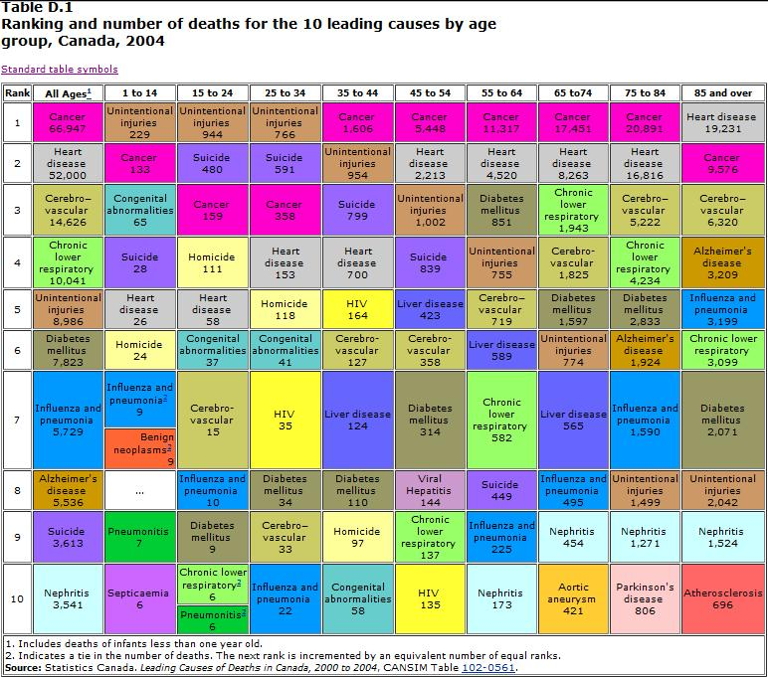

Slide 4
Conflict in Relationships
Conflict – a struggle or contest between people with opposing needs, idea, beliefs, values, or goals
Conflict is a part of life. Every relationship will face it, not having any conflict may be unhealthier.
Conflict can either weaken or strengthen a relationship. In some cases it may provide a stronger understanding of the other person and this can lead to more respect. In other cases it may cause resentment and hostility.

Slide 5
Relationship Conflict Resolution
Three Types of Healthy Solutions
1. Win-Win - BEST METHOD
Most conflicts have more than two alternatives. If you do not like the choice the other person wants, and they do not want the choice you have made. A alternative may be found were both sides can agree

Slide 6
Relationship Conflict Resolution
2. No lose.
When a alternative cannot be found were both win, look for an option that is acceptable to both parties. Neither will get everything that they wanted, but each gets enough to be satisfied.

Slide 7
Relationship Conflict Resolution
3. Win-lose Equally
If the conflict only has two choices, and there can only be one winner and one loser, there will be an agreement made that one person will get their way this time BUT the next time the other person will get their way.
This requires a lot of trust and should only be done with people you know very well.

Slide 8
Others
In other situations or confrontations with people you do not know, it is sometimes best to just walk away.

Slide 9
Stages of Healthy Conflict Resolution
1. Identify the problem or issues
Have a discussion to understand both sides of the problem, conflicts, needs and preferred outcomes.
Clarify to each other what exactly the conflict or problem involves.
You should say what you want and then listen to what your partner wants.
Use “I” and not “you”.
Use active listening skills.

Slide 10
Stages of Healthy Conflict Resolution
2. Generate Several Possible Solutions
Discuss what you both agree on.
Brain storm possible alternatives
Avoid judging and evaluating the ideas until the brain storming is done.

Slide 11
Stages of Healthy Conflict Resolution
3. Evaluate the alternative solutions
Consider each suggested solution and eliminate those that are not acceptable to either person.
Narrow the list down until only one or two seem like possible solutions for both sides.
Be honest and remember to use “I” terms to describe how it makes you feel

Slide 12
Stages of Healthy Conflict Resolution
4. Decide on the best solution
Select the alternative that is mutually acceptable to both of you.
Make sure there is mutual commitment to the decision.

Slide 13
Stages of Healthy Conflict Resolution
5. Implement the Solution
Talk about how to implement the solution
Who is responsible for doing what and by when?

Slide 14
Stages of Healthy Conflict Resolution
6. Follow-up evaluation
Not all solutions turn out as good as initially expected.
Ask your partner how the solution is working and how they feel about it.
Something may have been overlooked, misjudged, or the unexpected may have occurred.
Revisions are always possible but must be discussed and agreed upon.

Slide 15
Common Mistakes in Conflict Resolution
Not discussing with your partner the method used to resolve the conflicts.
If you are using this method and they are not it will not work.
Discovering too late that more information was needed.
Being too invested in getting your way, or making extreme demands, and therefore not being able to be flexible enough to be fair.

Slide 16
Common Mistakes in Conflict Resolution
Forgetting that there are usually several ways of doing things and that your own reality is not the only reality. Try to see the other person’s point of view and not just your own.
Focusing too much on what you could lose and not enough on what both of you could gain.
Believing the other person must lose for you to win
Bringing in additional issues before resolving the one you started.

Slide 17
Questions / Scenarios
For each of the following scenarios: I ( 3) C (3)
Say which healthy method you are going to use. (Win-Win, No lose and Win-Lose Equally)
Brainstorm a few ideas as to how the conflict could be resolved
How could one of your ideas be implemented

Slide 18
Scenario 1
Scenario: You and your significant other have been going out for 3 years. One of you wants to have a baby but the other does not as you are still in high school.

Slide 19
Scenario 2
Scenario: You are and your significant other having a fight over finances. They like to spend the money on things that are fun; you on the other hand only spend money on the bare essentials.

Slide 20
Scenario 3
Scenario: You and your significant other are living in Dundalk. You are currently both working part time jobs. They get a great, high paying job in Toronto. You do not want to leave all of your friends and family.

Slide 21
How to make a responsible decision

Slide 22
How to make a responsible decision
Many people have difficulty making decisions and then worry about it after they have made the decision.
“Did I do the right thing?”

Slide 23
Decision Making Model
?
A selection of steps that helps a person make a responsible decision.
1. State the problem
State the problem in a clear manner.
Should I go to college even though it takes a lot of time, money and work?

Slide 24
2. List the Options
Brain storm all of your possible options.
Decide to not go to school which may lead to working less desirable jobs that pay less
Take a college or university program and receive a diploma/degree in a specific job area.
Become an apprentice, make money while training and the finish off the schooling when the number of prerequisite hours have finished. Become a certified tradesperson.

Slide 25
3. Imagine the benefits and consequences
If need be, put them into a table.
This can be difficult as it can be hard to imagine the negative consequences
Make categories for the short term and long term benefits and consequences

Slide 26
4. Consider your Values
Values – a person’s strong beliefs and ideas. Your views of good and bad.
Universal values are:
Honesty, Trustworthiness, Responsibility, Self Control, Social Justice.

Slide 27
5. Weigh the Options and decide
Carefully examine the possible benefits and negative consequences of step three.
Which option has the most benefits and least consequences?
If you cannot decide, look at how the choice would affect your values.

Slide 28
6. Act
Plan out exactly what you will need to do.
1. Research jobs I would like to have
2. Find what colleges and universities offer those programs and what you will need to get into the course
Find out what you need to become an apprentice, find an apprenticeship.
3. Plan out how you will achieve the requirements.
4. Apply to the school or apprenticeship

Slide 29
7. Evaluate the Results
How well is the decision working?
How could you improve future decisions?
It is important to remember that even if things don’t work out, it doesn’t mean it was a bad decision.

Slide 30
Question- What would you do? I (7) C (7)
Practice the skill you just learned by using the 7 step process for the following situation.

Slide 31
Scenario
You know your friend Janice has been depressed lately, but every time you ask what’s wrong, she changes the subject. Then one day you notice a bruise on her face that she’s tried to cover up with makeup.
At first she tells you that she got hit in the face with a softball, but then she starts to cry and admits that her stepfather beat her up. “He knocks me around every time he has a bad day at work”. Janice says.”Mom doesn’t know about it because she gets home from work after he does.”
Why don’t you tell your mother about it?” you ask. But Janice shakes her head. “I don’t want to break up Mom’s marriage. She’s happier now than she’s been in a long time.” That night you keep thinking about Janice. You want to help your friend, but you don’t want to make her situation worse.

Slide 32
Scenario
What would you do?
Remember to use the decision making steps.
State the problem
List the options
Imagine the Benefits and Consequences
Consider your values
Weigh the options and decide
Act
Evaluate the Results

