Slide 1
Healthy Growth and sexuality
PPL3OI: Lesson 1

Slide 2
Sexuality Defined
When people see the words “sex” or “sexuality,” they most often think of sexual intercourse.
Sexuality is much more than that. It is an important part of who every person is. It includes all the feelings, thoughts, behaviours of being female or male, being attracted and attractive to others, and being in love, as well as being in relationships that include sexual intimacy and physical sexual activity.

Slide 3
Sexuality DEfined
Sexuality and reproductive health are interdependent
Sexuality is a natural and healthy part of living
Sexuality involves more than sex, and sex involves more than sexual intercourse
Sexual feelings and sexual behaviour are integral aspects of reproductive health

Slide 4
Sexual Health
Appreciation of one’s body
Able to negotiate and communicate sexual limits
Responsibility for one’s own behaviour
Understand the impact of media messages
Appropriate expressions of love and intimacy
Seek information about sexuality as needed
Understand consequences of sexual activity (talk with partner about sexual activity, limits,
contraception, and meaning of relationship, prior to sexual activity)
Identification of values
Practice health promoting behaviours (regular check-ups: pap, testicular exams)
Appropriate and respectful interaction with both sexes
Avoid exploitative relationships

Slide 5
Reproductive Health
Anything pertaining to or affecting reproduction
The physical ability to produce offspring
Pre-conceptual health (nutrition, physical activity, etc.)
Awareness of what is normal and abnormal in regards to reproductive organs (discharge, lumps, etc.)
Prenatal health (nutrition, physical activity, etc.)

Slide 6
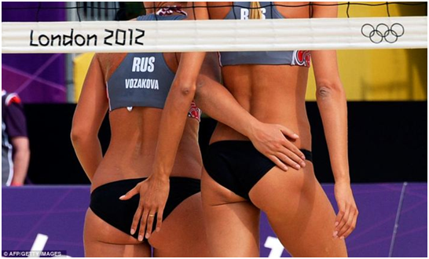
Sexualization
The use of sexuality to influence, control, or manipulate others.

Slide 7
Sexual Identity
The development of a sense of who one is sexually, including a sense of maleness and femaleness

Slide 8
Intimacy
The ability and need to experience emotional closeness to another human being and have it returned.

Slide 9
Sexual identity
The development of a sense of who one is sexually, including a sense of maleness and femaleness
GENDER and SEX are different things.
SEX is a physical form and function of a person.
GENDER is the identity of the person inside of the body.

Slide 10
Sexual diversity
The full range of sexuality which includes all aspects of sexual attraction, behaviour, identity, expression, orientation, relationships and response.
It refers to all aspects of humans as sexual beings
LGBTTQ2: Acronym for Lesbian, Gay, Bisexual, Transsexual, Transgender, Queer and Two Spirited.

Slide 11
Trans-Identified: Any person who considers himself or herself to have issues pertaining to gender identity. This person may or may not be transsexual
Transsexual: The GENDER of the brain is the opposite of the SEX of the body.
Transsexuality is marked by 2 key factors:
- The person does not feel comfortable in his or her own body, and considers himself or herself to identify with the opposite sex.
- Feelings of transsexuality occur much before puberty, sometimes early on in life.
Transgendered: An umbrella term used loosely to describe anyone who does not fit “ordinary” definitions of gender. These people have no intention of undergoing hormonal treatments or surgery, but will identify with the opposite gender (through crossdressing, or partial transition).
GENDER remains the same. SEX changes.
Transvestite: Is someone who, at puberty, will develop a powerful fascination or sexual fetish with dressing as the opposite sex. This is done purely for pleasure, and has nothing to do with the actual interest in changing sex. Roughly 30% of males are reported to have participated in some sort of transvestite activity

Slide 12
Time for some questions…
John Oliver- Transgender
Language warning

Slide 13
Gender dysphoria
“Is the condition of being in a state of conflict between gender and sex”
Although there is no known reason for Gender Dysphoria, studies have found two commonalities:
Thoughts begin years before puberty, possibly even from birth
Links have been formed between a hormonal imbalance in the child’s mother during pregnancy and people with gender dysphoria

Slide 14
Two-spirited
A male-female gender
Native American concept.
A gift from the creator of living in the house of both male and female.
Can see the world from two perspectives.
Treated with the greatest respect, and held important spiritual and ceremonial responsibilities
Settlers and European religion where against the Two spirited. So they attempted to remove it from Native culture.

Slide 15
Brown University
Total number of people whose bodies differ from standard male or female – One in 100 births
Total number of people receiving surgery to “normalize” genital appearance – One or two in 1000 births

Slide 16
Questioning
Questioning is a term that can refer to a person who is questioning their gender, sexual identity or sexual orientation. People who are questioning may be unsure of their sexuality, or still exploring their feelings

Slide 17
John Oliver
John Oliver LGBT Discrimination
Language Warning

Slide 18
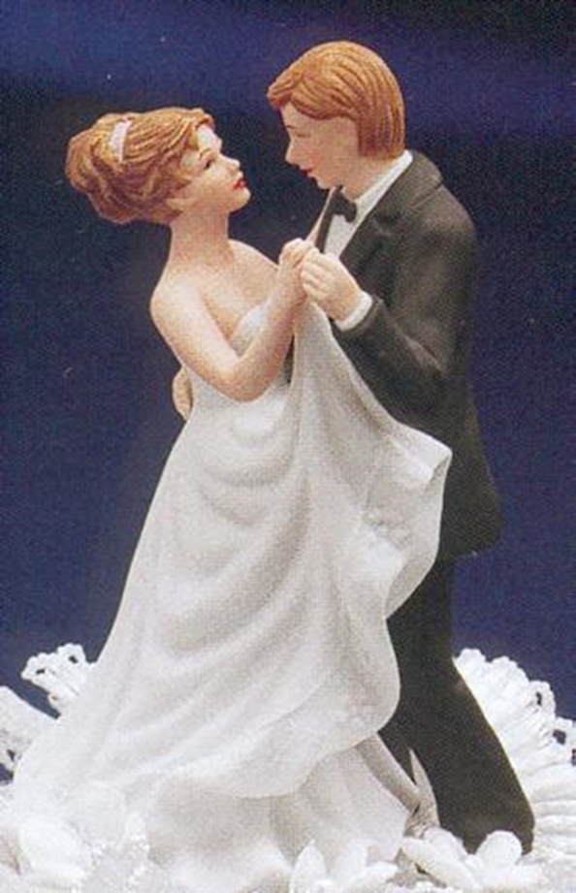
Heterosexism
The socially constructed
belief that
heterosexuality is normative,
natural and thus superior

Slide 19
Homophobia
Discrimination against individuals who identify as anything but heterosexual
Occurs in many forms ex. Graffiti, verbal harassment, violence ex. “That’s so gay.”
Homophobia is generally thought to be a learned behavior resulting from many factors: family, culture, religious values, political views …
Because homophobia is learned, it can be UNLEARNED

Slide 20
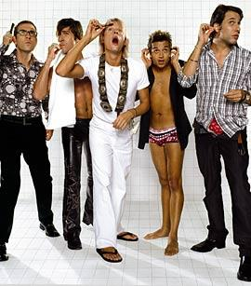
Stereotypes are problematic
Lets think of a list of stereotypes that are inherently male. Female
Lets think of a list of stereotypes for gay men, lesbians, bisexual

Slide 21
Coming out
A lifelong process of recognizing and accepting an LGBTTQ2 identity.
Individuals may be “out” to certain people, but not to everyone.
If you talk to someone, make sure it is one you can trust (Ex: Friends, Counselors, Teachers)
What should you do if someone comes out to you?
There is no perfect response.
Be informed; educate yourself.
Respect confidentiality.
Do not take control; it is a personal decision

