Slide 1
Self Esteem
Feeling good about yourself and the things you do
Gives sense of confidence
Pay attention to positive aspects in your life
Make a list of things you do well
Use positive self talk. Talk to yourself in a positive way
Avoid all negative self talk
Be good at something. Developing your skill in whatever you are good at will make you more confident
Resist peer pressure: The more you make decisions based on what you think and not others the more confident you will become.
Use I statements. Take responsibility for your feelings and words by using “I” statements

Slide 2
Self Esteem
Accept yourself
Appreciate yourself and believe in your worth
Realistically assess your strengths and weaknesses
Do not judge yourself by unrealistic standards
Be ok with who you are right now
Only expend energy on changing things you have control over.

Slide 3
Sense of Control
High self esteem gives you a sense of control internal locus of control
Those with low self esteem feel that events affecting them are beyond their control. - External locus of control
The reality is that you will always have some control in your life

Slide 4
Self Concept: The current mental image you have of yourself
Rating your level of self esteem requires you to evaluate how you look at yourself as a person.
Self-ideal – The mental image of what you would like to be. If you self-ideal is realistic, set goals to reach it.

Slide 5
When to Seek Help for Mental and Emotional Health Problems
You may need to obtain professional help with your problems if you experience any of the following characteristics:
A prolonged feeling of depression and hopelessness
A feeling that life is out of control
When your feelings and/or actions start to impede upon your regular, daily existence
The inability to concentrate and make decisions
Difficulty getting along with family and friends
Intense fears
Persistent difficulty sleeping
Emotional problems coping with a physical illness
Inability to stop destructive behaviours like drinking, overeating, and abusing drugs.

Slide 6
Mental and Emotional Health Therapies
The goal of therapy is to help a person work through difficulties so that they can return to normal activities.
It should also prepare the person for dealing with future challenges

Slide 7
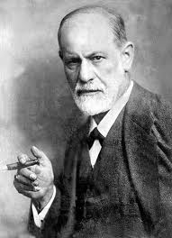
Psychoanalysis
A form of theory used to examine unresolved issues or conflicts from the past.
The issues or conflicts may have been forgotten but still affect the person latter in life until they are resolved.
Developed by Sigmund Freud
The idea is to examine the past experiences to improve awareness
Improved awareness helps the person understand and resolve the problem.

Slide 8
Behavioural Therapy
Focuses on the patients behaviour rather than underlying causes
The therapist helps the patient discover rewards for desirable behaviours and punishments for undesirable behaviours.
Behaviour Modification

Slide 9
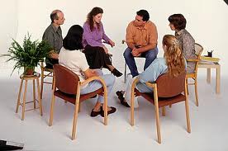
Group Therapy
In group therapy, people with similar problems meet with a therapist to discuss their problems.
Both the therapist and group members suggest possible solutions
The idea is that input from the group members is more helpful than one perspective from the therapist.

Slide 10
Chemical Therapy
The use of drugs to treat mental and emotional disorders.
The drugs are prescribed to help control some symptoms of the disorder.
Example: aggressiveness or an imbalance of chemicals
The drugs can have serious physical side effects and in some cases make the person worse off.
Example: Causes the person to be violent or suicidal.

Slide 11
Cognitive therapy
Based on the interpretation of situations that determine how an individual feels and behaves.
Based on the premise that cognition, the process of acquiring knowledge and forming beliefs, is a primary determinant of mood and behaviour.
Behaviour is secondary to the way people think about themselves and their roles in the world: maladaptive behaviour arises from ingrained stereotyped thoughts.

Slide 12
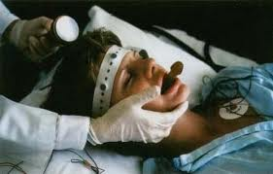
Electroconvulsive therapy (ECT)
Often referred to as ‘shock therapy’ or ‘electrotherapy’.
It has been used for many decades for the treatment of more severe psychiatric disorders and has a reputation as a cruel and inhumane form of treatment.

Slide 13
Electroconvulsive therapy (ECT)
The exact mechanism of action of ECT is unclear but it is thought that the electric shock induces epileptic fits/seizures that result in a massive release of neurotransmitters in the synaptic clefts.
This sudden increase in neurotransmitter release is thought to help re-establish the normal concentrations of neurotransmitters in the brain.

Slide 14
Electroconvulsive therapy (ECT)
https://www.youtube.com/watch?v=KsXZ5NKrwpc

Slide 15
Questions
How would you know if a friend or someone in your family needed counselling? K (1)
How does Group Therapy differ from behaviour modification? I (1)
What are 4 possible treatments to mental disorders? K (1)
Based on what you know, if you had a problem or have one, what method would you like to use and why? I (1)

